Slide 1
Introduction to HPC Parallel Programming
Training Module
10/21/2021

Slide 2
Overview:
Introduction to HPC Parallel Programming
What is HPC?
Penalization approaches (shared memory, distributed memory, data parallel).
Optimization approaches
Shared memory C++ example with OpenMP
Distributed memory Python example with MPI (mpi4py)
Data parallel example with Slurm job arrays
NOTE: This tutorial is designed to be interactive.
We recommend using a shell on Discovery to execute the commands.

Slide 3
Obtaining the material
Download the Introduction_to_HPC_Parallel_Programming.zip to your local machine.
Copy the training material to your $HOME directory on Discovery. You can use one of these options:
Using the File Explorer on OOD: https://ood.discovery.neu.edu/ Instructions: https://rc-docs.northeastern.edu/en/latest/using-ood/fileexplore.html
Using ’scp’ through the terminal/shell: https://rc-docs.northeastern.edu/en/latest/using-discovery/transferringdata.html?highlight=scp#
Access a Discovery Linux shell/terminal (use one of the following options):
Terminal/shell SSH: https://rc-docs.northeastern.edu/en/latest/get_started/connect.html
OOD shell: https://ood.discovery.neu.edu/pun/sys/shell/ssh/ood.discovery.neu.edu
Unzip and access the material using these commands:
$ unzip ~/Introduction_to_HPC_Parallel_Programming.zip $ cd ~/Introduction_to_HPC_Parallel_Programming

Slide 4
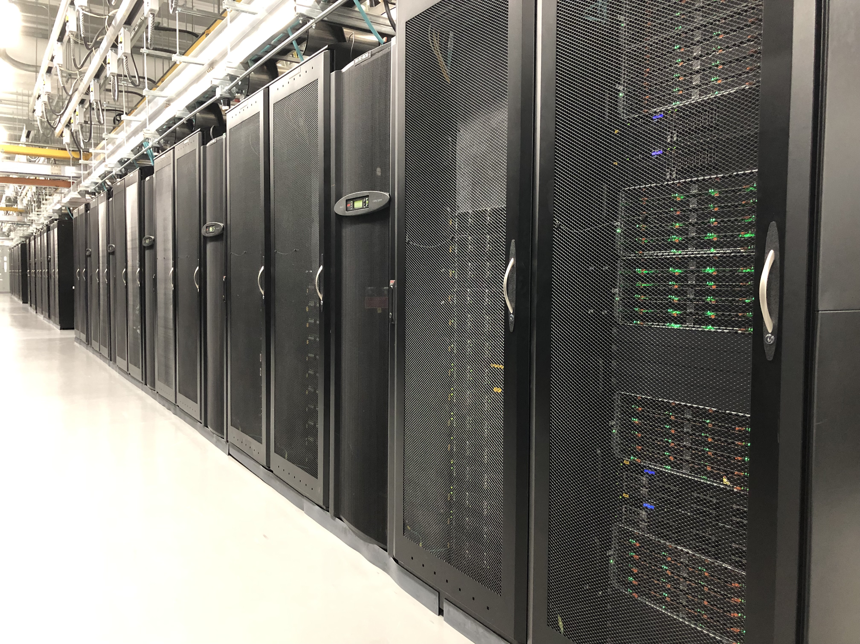
What is HPC?
Computing on a system (such as Discovery) with processing capacities at the frontline of contemporary abilities.
Typically, HPC systems are many powerful computers connected via a computer network.
HPC relies on parallel computing technologies to achieve high performance.
Notes:
High Performance Computing (HPC) is performing computations on a so-called supercomputer, which is usually a system that is considered at the frontline of contemporary processing capacity. The processing capacity is mainly evaluated based on the processing speed and the memory capacity. Typically, this is achieved through connecting many powerful computers together into a computer cluster via a computer network, so that the many connected computers can be used as a single machine. The HPC system relies on parallel computing technology in order to process data extremely fast.
Discovery Cluster in the MGHPCC (Holyoke, MA)
24,000 CPU cores
over 200 GPUs
Connected to Northeastern via 10 Gbps Ethernet (GbE)
Active, archive, secure, and cloud storage solutions

Slide 5
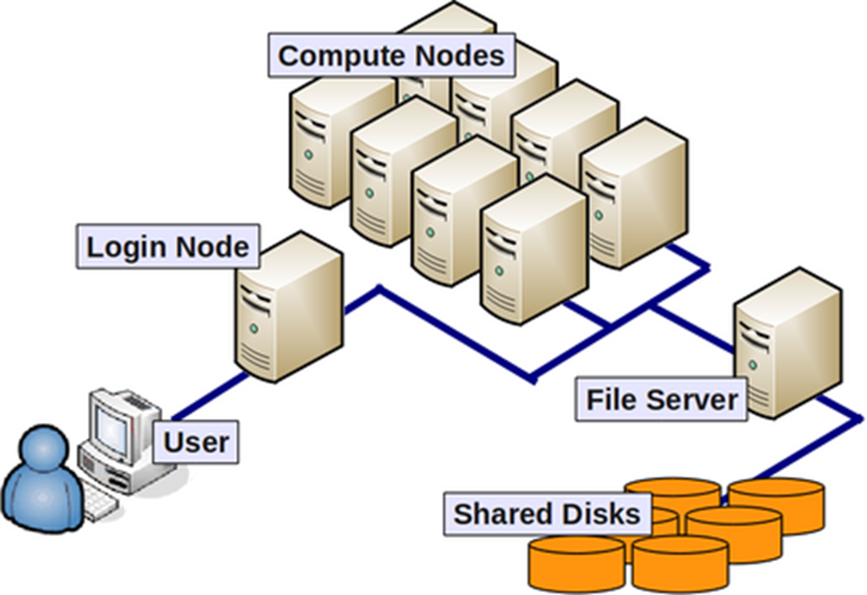
General terminology
Compute nodes: servers that perform HPC calculations.
Login nodes: servers for remote connection to the cluster.
Network: connect between nodes (LAN).
File system servers: manage cluster shared storage.
Scheduler: manages HPC resources between users.
Image from: https://wiki.rc.hms.harvard.edu/display/O2/O2+HPC+Cluster+and+Computing+Nodes+Hardware
Notes:
Compute node / Node - a standalone computer/server/worker node in the cluster, which is running its own instance of the operating system (typically, Linux-OS like CentOS) and is interconnected with the other nodes via a network. Usually has multiple CPUs/processors/cores a separate memory, network interfaces, etc.
CPU / Socket / Processor / Core - may vary upon context and manufacturer. Initially, a CPU (Central Processing Unit) was referred to a single component within a computer. When multiple CPUs were introduced, each CPU was subdivided into multiple "cores", which were considered single processing units. Sockets are referred to as CPUs with multiple cores, though this term can depend on the vendor.
Task - A logical section of a computational workflow, typically a program or a set of instructions that is executed by a parallel unit. A parallel program consists of multiple tasks executed simultaneously.
Network - different nodes in the cluster are usually connected to each other through fast local area networks (LAN). Faster connections like InfiniBand (IB) connection provide high throughput and low latency.
Partition - (on the Discovery cluster) are groups of nodes that are grouped into logical sets.
Clock cycle - the speed unit of a CPU and corresponds to the electronic pulse of a CPU, during which the CPU performs a basic operation.

Slide 6
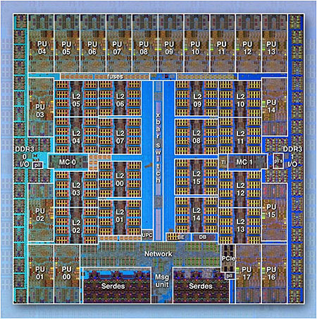
General terminology
IBM BG/Q Compute Chip with 18 cores (PU) and 16 L2 Cache units (L2)
Processor/CPU/Core: Central Processing Unit – a single processing component within a computer.
Socket: CPUs with multiple cores (terms depends on vendor).
Task: A logical section of a computational workflow executed by a parallel unit.
Parallel Program: consists of many tasks that can be executed in parallel.
Image from the Lawrence Livermore National Laboratory Computing: https://computing.llnl.gov/
Notes:
Compute node / Node - a standalone computer/server/worker node in the cluster, which is running its own instance of the operating system (typically, Linux-OS like CentOS) and is interconnected with the other nodes via a network. Usually has multiple CPUs/processors/cores a separate memory, network interfaces, etc.
CPU / Socket / Processor / Core - may vary upon context and manufacturer. Initially, a CPU (Central Processing Unit) was referred to a single component within a computer. When multiple CPUs were introduced, each CPU was subdivided into multiple "cores", which were considered single processing units. Sockets are referred to as CPUs with multiple cores, though this term can depend on the vendor.
Task - A logical section of a computational workflow, typically a program or a set of instructions that is executed by a parallel unit. A parallel program consists of multiple tasks executed simultaneously.
Network - different nodes in the cluster are usually connected to each other through fast local area networks (LAN). Faster connections like InfiniBand (IB) connection provide high throughput and low latency.
Partition - (on the Discovery cluster) are groups of nodes that are grouped into logical sets.
Clock cycle - the speed unit of a CPU and corresponds to the electronic pulse of a CPU, during which the CPU performs a basic operation.

Slide 7
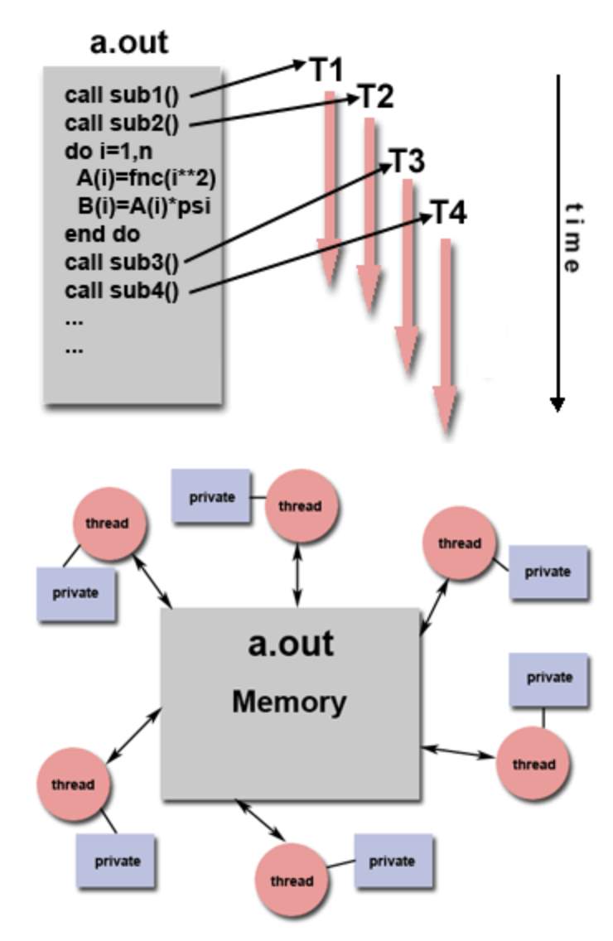
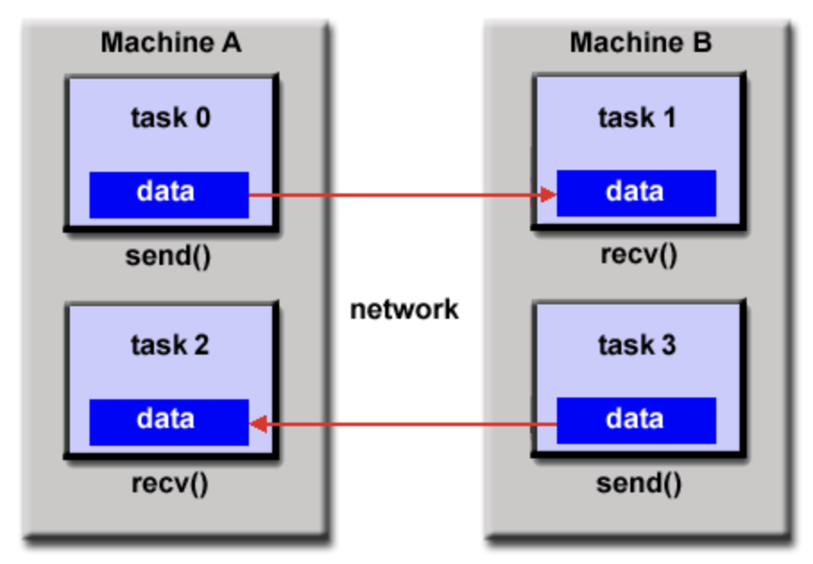
Parallelization approaches
Multi-thread model
Distributed model
Use CPU-parallel code:
Use on the entire data set.
Shared memory (single node): master process controls many ”light-weight” threads (multi-threading).
Distributed memory (single/multi node): multiple processes with local memory each, managed by a master process or MPI protocol.
Use a data-parallel approach:
Split the data, perform the same operation on different data.
Data-parallel model
Data: [d1,d2,d3,d4]
d1
d2
d3
d4
Job1
Job2
Job3
Job4
CPU1
CPU2
CPU1
CPU2
Node 1
Node 5
Images from: https://www.futurelearn.com/courses/supercomputing/0/steps/24017
Lawrence Livermore National Laboratory Computing: https://computing.llnl.gov/

Slide 8
Optimization approaches
To run efficient HPC workloads:
Ensure software is suitable for the hardware (CPU architectures, GPU, etc.) and network (Ethernet/InfiniBand).
Leverage multi-CPU and multi-node architectures with parallel computing libraries (OpenMP, MPI, CUDA etc.).
Utilize optimized libraries (if applicable) - mathematical libraries (MKL, OpenBLAS etc.).
Run benchmarks to find the best performance configuration.
Test scalability by increasing the resources and evaluating efficiency.

Slide 9
Exercise 1 Shared Memory Parallelization using OpenMP

Slide 10
Exercise 1 Task 1: Parallel C++ code and multi-CPU allocation
This exercise we’ll test performance of a C++ vector multiplication code in parallel by using multiple threads (CPUs/cores).
Enter directory Exercise_1 and inspect the C++ script vecMult.cpp: Note that the Parallel code segments start with the following statement:
Inspect the SLURM shell script: submit.bash: Note that the max number of OpenMP threads defined is equal to the total CPUs requested:
$ cd Exercise_1
$ cat vecMult.cpp
#pragma omp parallel for
$ cat submit.bash
#SBATCH --cpus-per-task=16 export OMP_NUM_THREADS=16

Slide 11
Exercise 1 Task 2: Run and analyze performance
Note that copy+paste of some commands may not work due to Microsoft font formatting.
Please use the commands provided in the “interactive_commad_list” instead.
Submit the job and check if the job completes by typing:
Once completed, inspect output files. The file performance.all includes the runtime averages for each core count.
Analyze the runtime performance by running the Python script in the given notebook: calc_performance.ipynb. You can open the file using the OOD Jupyter notebook app: https://ood.discovery.neu.edu/pun/sys/dashboard/batch_connect/sys/jupyter/session_contexts/new
The script will produce a plot of runtime vs. number of cores/threads. What is the optimal number of cores/threads to use?
$ sbatch submit.bash $ squeue –u $USER --all

Slide 12
Exercise 2 Distributed Parallelization using MPI

Slide 13
Exercise 2 Task 1: Run a Python job with mpi4py
In this example, we’ll run parallel matrix operations in Python using multiple MPI processes in a distributed memory model.
Inspect the Parallel Python code calcMatrix.py:
Inspect SLURM script main_py.bash:
The script loads the MPI and python environment by using a Discovery anaconda3 module.
The script runs MPI by invoking the mpirun command. The flag –n specifies the number of MPI ranks.
Submit the job:
Note that copy+paste of some commands may not work due to Microsoft font formatting.
Please use the commands provided in the “interactive_commad_list” instead.
$ cd Exercise_2; cat main_py.bash
$ cat main_py.bash
$ sbatch main_py.bash
Notes:
## NOTE:
If you already have a conda version loaded (in ~/.bashrc) – use:
$ conda deactivate
$ module purge
As a best practice, NEVER load a conda environment into your ~/.bashrc
See: https://rc-docs.northeastern.edu/en/latest/using-discovery/bashrc.html?highlight=bashrc
Note that copy+paste of some commands may not work due to Microsoft font formatting.
Please use the commands provided in the “interactive_commad_list” instead

Slide 14
Exercise 2 Task 2: Calculate basic performance
Check if the job completes by typing:
Once completed, inspect output files. The file performance.all includes the runtime averages for each core count.
Analyze the runtime performance by running the Python script in the given notebook: calc_performance.ipynb. You can open the file using the OOD Jupyter notebook app: https://ood.discovery.neu.edu/pun/sys/dashboard/batch_connect/sys/jupyter/session_contexts/new
The script will produce a plot of runtime vs. number of cores/MPI processes. What is the optimal number of cores/MPI processes to use?
$ squeue –u $USER --all

Slide 15
Exercise 3 Distributed data parallelization

Slide 16
Exercise 3 Task 1: Run data-distributed job using job arrays
Inspect the SLURM script submit.bash (runs a simple python program getMax.py on different number lists in different files):
The script creates a job array of 4 jobs, named 1-4, and runs them all at the same time (--array=1-4%4).
The shell variable $SLURM_ARRAY_TASK_ID takes values 1-4, based on the job ID, so it is used to specify a specific data file list1, list2, list3 or list4: list$SLURM_ARRAY_TASK_ID
Alternatively, all file names can be read from a file (all-lists), where each job array will read a different line number in the file to get the data.
Submit the SLURM array job:
$ cd Exercise_3
$ cat submit.bash
$ sbatch submit.bash; squeue –u $USER --all
Notes:
Note that copy+paste of some commands may not work due to Microsoft font formatting.
Please use the commands provided in the “interactive_commad_list” instead.

Slide 17
Additional useful resources

Slide 18
Parallel computing - useful resources and links
Multiprocessing library for Python (single node only): https://docs.python.org/3/library/multiprocessing.html
Parallel programming with numpy and scipy: https://scipy.github.io/old-wiki/pages/ParallelProgramming
Getting started with parallel programming in R: https://towardsdatascience.com/getting-started-with-parallel-programming-in-r-d5f801d43745
Using MATLAB Parallel Server on Discovery: https://rc-docs.northeastern.edu/en/latest/software/matlab.html#using-matlab-parallel-server

Slide 19
Thank you for your participation in this RC tutorial! Visit our website: https://rc.northeastern.edu/ Enjoy your computing!

Slide 20
Supplemental Material

Slide 21
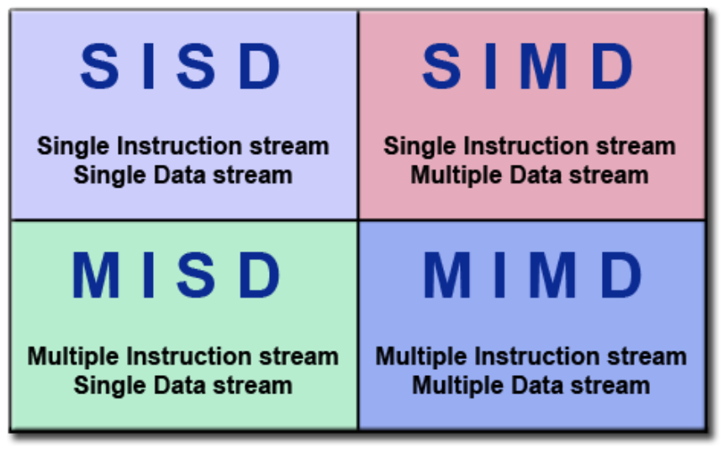
Parallel computing models
We’ll focus on parallel computing to increase performance.
Flynn’s Classical Taxonomy:
A parallel computing classification model that distinguishes architectures based on two parameters:
Instruction stream
Data stream
Where each can be single or multiple.
Image from the Lawrence Livermore National Laboratory Computing: https://computing.llnl.gov/
Notes:
One widely used classification model for parallel computing is "Flynn's Classical Taxonomy", which distinguishes computer architectures based on two parameters: Instruction Stream and Data Stream, where each can be either single or multiple. These models are fairly abstract so we'll use a "processing unit" which may refer to either a core, a CPU, a processor, a computer or a set of computers.

Slide 22
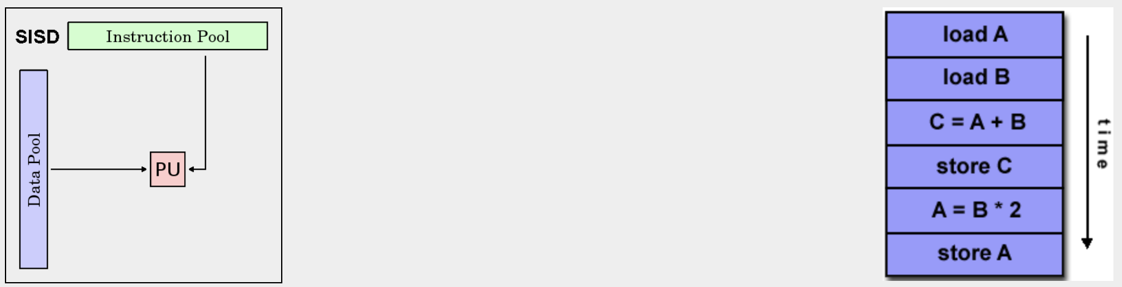
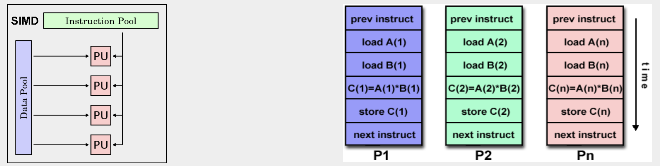
SISD & SIMD
Single Instruction, Single Data (SISD): a single processing unit performs a single instruction on a single data stream during one clock cycle.
Single Instruction, Multiple Data (SIMD): a single instruction is executed by multiple processing units on different data elements at any given clock cycle.
Images from the Lawrence Livermore National Laboratory Computing: https://computing.llnl.gov/
Notes:
Single Instruction, Single Data (SISD) - non-parallel architecture where a single processing unit performs a single instruction on a single data stream during one clock cycle.
Single Instruction, Multiple Data (SIMD) - a type of parallel architecture, where a single instruction is executed by multiple processing units on different data elements at any given clock cycle. Suitable for types of problems such as graphics and image processing, and employed by graphics processor units (GPUs).

Slide 23
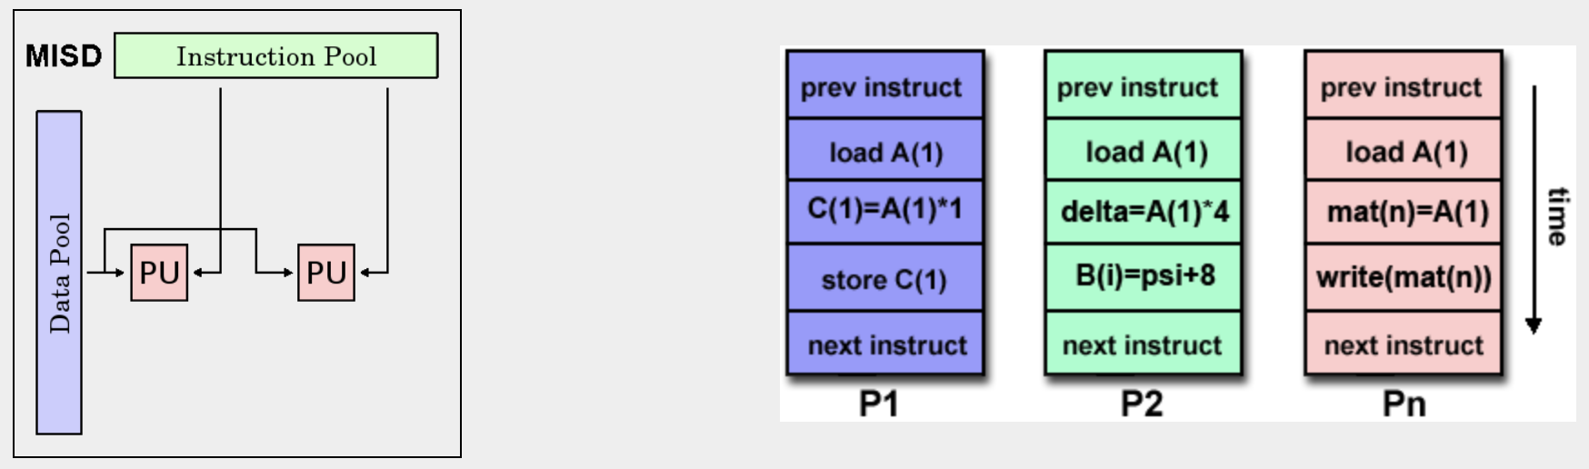
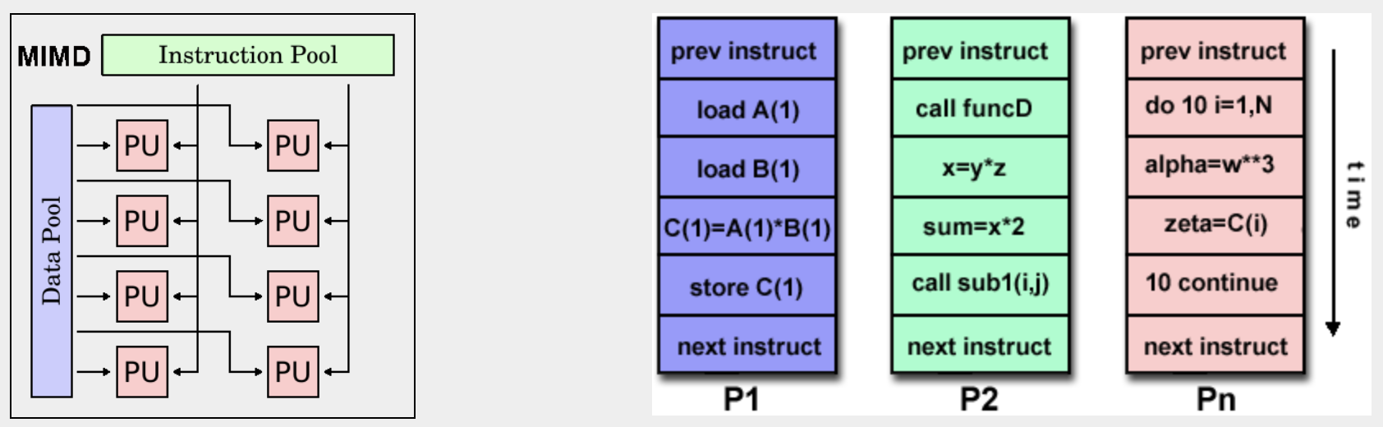
MISD & MIMD
Multiple Instruction, Single Data (MISD): each processing unit operates a different multi-instruction stream on the same data (least common).
Multiple Instruction, Multiple Data (MIMD): every processing unit may execute a different instruction with a different data stream (most common).
Images from the Lawrence Livermore National Laboratory Computing: https://computing.llnl.gov/
Notes:
Multiple Instruction, Single Data (MISD) - a type of parallel architecture, where each processing unit operates a different multi-instruction stream on the same data. This is the least common class of parallel architectures and few (if any) were implemented.
Multiple Instruction, Multiple Data (MIMD) - the most common type of a parallel architecture, where every processing unit may execute a different instruction with a different data stream. Most modern supercomputers fall into this category as well as networked parallel computers and "grids", multi-processor SMP computers and multi-core PCs. Note that this category often contains SIMD sub-components.

Slide 24
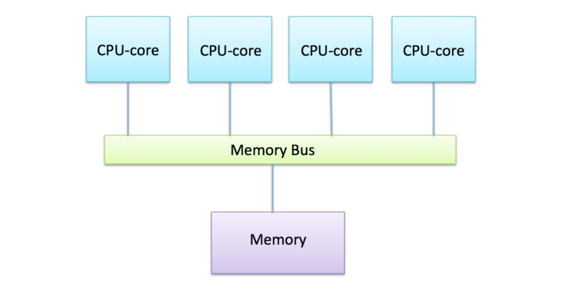
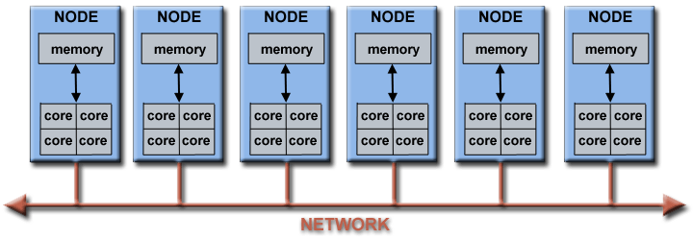
Parallel architectures
Shared memory
Shared memory: all processors share a global address space.
Distributed memory: each processor has local memory (cache) that is not visible to other processors.
Hybrid (distributed + shared): is the most common in HPC:
Inside the node – shared memory
Between nodes – distributed memory
Distributed/Hybrid memory
Images from: https://www.futurelearn.com/courses/supercomputing/0/steps/24017
Lawrence Livermore National Laboratory Computing: https://computing.llnl.gov/
Notes:
Shared memory architectures - are characterized by the ability of all processing units to access it as a global address space. Cache coherency is maintained in a shared memory environment. The two main classifications:
Uniform Memory Access (UMA) - represented by Symmetric Multiprocessor (SMP) machines, with identical processors and equal access times.
Non-Uniform Memory Access (NUMA) - often made by linking several SMP machines, resulting in different accessing times to different memory elements.
Distributed memory architectures - each processing unit has its own local memory on which it operates independently. Changes made in a processor's local memory are not visible to other processors, hence access of data and communication between processors requires the explicit interpretation by the programmer.
Hybrid distributed-shared memory - the most common memory architecture for HPC, where both shared and distributed memory is employed. Shared memory components may be a shared memory node or GPUs and the distributed component is the networking between different machines.

Slide 25
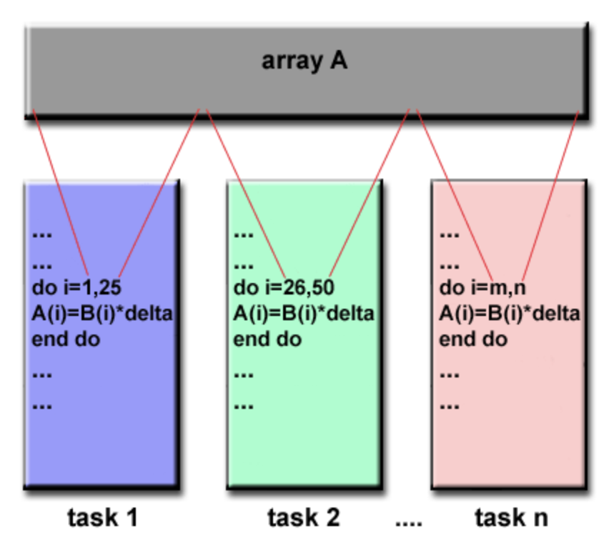
Data parallel model (PGAS)
Partitioned Global Address Space (PGAS) involves a shared data structure segmentation by task.
Each task typically performs the same operation on a different data segment.
Data structure can be shared memory or distributed memory.
The programmer specifies data distribution and alignment.
Images from the Lawrence Livermore National Laboratory Computing: https://computing.llnl.gov/
Notes:
Data parallel / Partitioned Global Address Space (PGAS) model - in this model, many task operate on the same data structure, but each task operates on a separate section of the data. The data structure itself can be either on shared memory or in a distributed memory (global address space), but is distributed between the local memory portions of each task. In this model, the programmer has to specify and distribution and alignment of the data. All tasks usually perform the same operation on a different data segment. On distributed Memory architectures, the data can be split logically and/or physically across tasks.

Slide 26
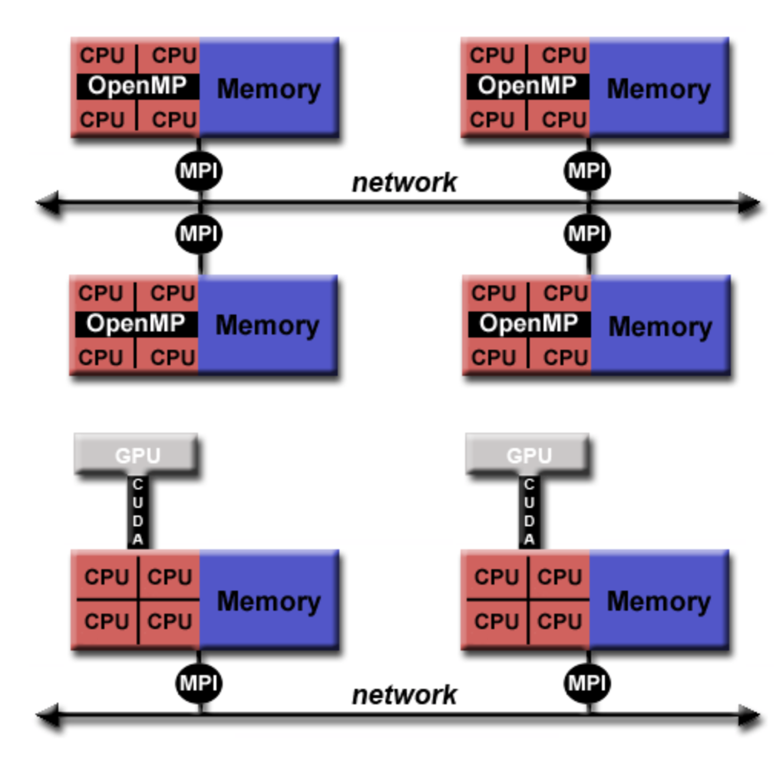
Hybrid model
Combines several of the previously described models.
The most popular models:
MPI-OpenMP:
OpenMP threads are used within each node for shared memory.
MPI processes are used for communication between nodes.
CPU-GPU with MPI: the Graphic Processing Unit (GPU) is combined with CPUs and MPI processes run on CPUs to communicate over the network.
Images from the Lawrence Livermore National Laboratory Computing: https://computing.llnl.gov/
Notes:
Hybrid Model - combines one or more of the previously described models. The two most popular once are:MPI-OpenMP: a common example of a hybrid model is the combination of a message passing model (MPI) with the threads model (OpenMP).
OpenMP threads use an on-node shared-memory model, which are computationally intensive.
MPI processes communicate between multiple nodes over the network.
CPU-GPU with MPI: the Graphic Processing Unit (GPU) is combined with CPUs and MPI processes run on CPUs to communicate over the network.
Computationally intensive kernels are off-loaded to GPUs internal to the node.
GPUs use CUDA for data exchanges on the node memory.

Slide 27
OpenMP & MPI basics

Slide 28
OpenMP & MPI basics
OpenMP in C++ code:
To use OpenMP library in C++, we added line, which includes OpenMP headers:
Parallel code segments start with the following statement:
The GNU (g++) compiler supports OpenMP and can be used to compile C++ with OpenMP.
MPI concepts (Python objects):
Rank – the MPI process ID.
Communicator – connects groups of processes (Comm class).
Point-to-point communication – includes basic commands (send(),recv()).
Collective communication – involves communication between groups of processes (bcast(),scatter(),gather()).
Collective communicators will distribute/collect data evenly across all ranks.
#include <omp.h>
#pragma omp parallel for
OpenMP principles:
Uses the “fork-join” method: a single master process forks multiple threads at parallel parts of the code, then joins them.
Most data is shared. Can be further controlled by programmer.
No I/O synchronization.

Slide 29
MPI on Discovery
MPI
Though MPI has be standardized, there are many library implementations:
Open MPI:
MPICH:
MVAPICH2:
Intel MPI:
Discovery has multiple MPI modules to chose from.
You should always use MPI libraries suitable to the type of compiler you are using.
Most commonly used compilers:
Intel compilers:
GNU compilers:
$ module avail openmpi
$ module avail mpich
$ module avail mvapich2
$ module avail intel
$ module avail intel
$ module avail gcc
Note: MPI module names will include the compiler, unless compiled with the default GNU 4.8.5 OS compiler.
Notes:
MPI is the industry standard for message passing. It is practical, portable, efficient and flexible.
MPI interface specifications include C++ bindings, MPI-3 has FORTRAN support and mpi4py has an interface MPI for python.
Although the MPI interface has been standardized, actual library implementations vary. For example:
MVAPICH & Open MPI work on Linux OS and is built for the GNU, Intel, PGI and Clang compilers.
Intel MPI works on Linux OS and built for the Intel and GNU compilers.
IBM BG/Q MPI work on the BG/Q clusters and IBM and GNU compilers
Note: Our cluster contains multiple compiler types, most used:
Intel compilers: intel/2019-4, intel/compilers-2020u2
GNU compilers: gcc/5.5.0 gcc/6.4.0 gcc/7.3.0 gcc/8.1.0, gcc/9.2.0 and gcc/10.1.0.
You should always use MPI libraries suitable to the type of compiler you are using. Discovery also has many different MPI implementations such as:
OpenMP MPI - module avail openmpi to see full list of options. Most modules will have the compiler listed in the module name, unless it was compiled with the default GNU 4.8.5 OS compiler. For example, typing module show openmpi/4.0.3-skylake-gcc7.3 will show the full details of the module - it was compiled using GNU 7.3.0 on the Skylake architecture (d-nodes) and supports Infiniband network.
MPICH MPI - module avail mpich to see the full list of options.
MVAPICH2 MPI - module avail mvapich to see the full list of options.
Intel MPI - module avail intel to see the full list of options (includes compilers too). MPI modules include: intel/mpi-2020u2 and intel_mpi/2018u5.
Our current module system does not implement restrictions on loading incompatible modules, so please be aware of potential bugs by doing that!

Slide 30
Evaluating advanced performance metrics

Slide 31
Performance evaluation
Software may perform differently depending on many factors (libraries, compilers, hardware, network etc.).
Benchmarking your code against different components is good HPC practice.
Popular performance metrics:
Speedup – shows parallel benefit
Efficiency – how well CPUs are used
Scaling – overall ability to be parallely-efficient
For more info see: 30. Evaluating advanced performance metrics
Notes:
Because parallel programs depend on many hardware and software components, it is often the case that they do not perform the same on different machines/architectures/OS. It is a good practice to benchmark your code against the various computer hardware and software components you are planning to work with.
There’s a need for performance metrics and software tools to evaluate the performance and decide its use is convenient or not. Since the focus of parallel computing is to solve large problems in a relatively short time, there are several factors that may contribute to this evaluation:
The type of hardware used
The degree of parallelism of the problem
Which parallel model is being used.
The performance is achieved by analyzing and quantifying the number of threads and/or the number of processes used and comparing the parallel algorithm with the sequential algorithm. Here, we introduce a few possible performance metrics: speedup, efficiency and scaling.

Slide 32
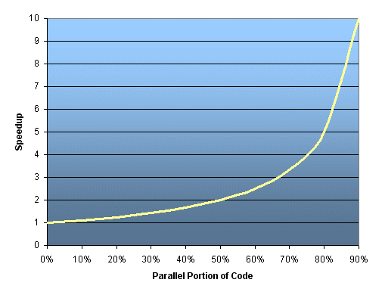
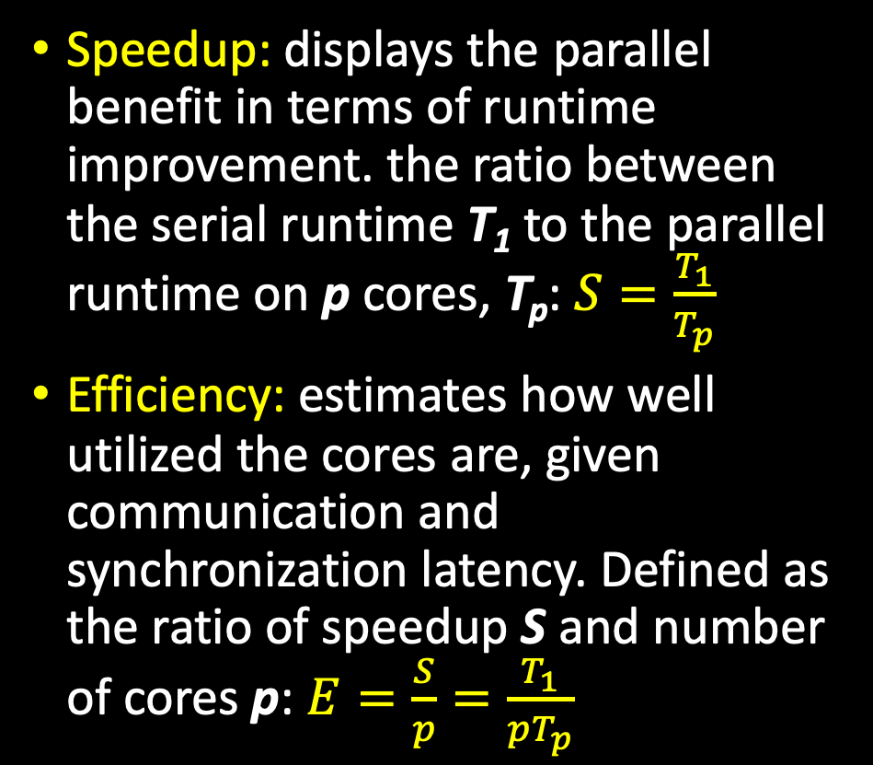
Performance metrics
Speedup: displays the parallel benefit in terms of runtime improvement. the ratio between the serial runtime T₁ to the parallel runtime on p cores, T_{p}: $S=\frac{T_{1}}{T_{p}}$
Efficiency: estimates how well utilized the cores are, given communication and synchronization latency. Defined as the ratio of speedup S and number of cores p: $E=\frac{S}{p}=\frac{T_{1}}{pT_{p}}$
Images from the Lawrence Livermore National Laboratory Computing: https://computing.llnl.gov/
Notes:
Speedup - a measure that displays the benefit of solving a problem in parallel. Speedup 𝑆S is defined as the ratio between the time it takes to run a problem in serial 𝑇1 (or on a single processing element) to the time required to solve the identical problem on p identical processing elements, 𝑇𝑝:
𝑆=𝑇1/𝑇𝑝
When 𝑆=𝑝 the speedup is considered linear. 𝑆<𝑝S<p is real speedup and 𝑆>𝑝S>p is super-linear speedup.
Efficiency - is a measure that estimates how well utilized the processing elements are at solving a task, compared to how much effort is wasted on communication and synchronization. Efficiency 𝐸 is defined as the ratio of the speedup S by the number of processing elements 𝑝:
𝐸=𝑆/𝑝=𝑇1/𝑝∗𝑇𝑝
When the speedup is linear, the efficiency becomes 1, otherwise E<1. E<<1 means that the program does not parallelize well.

Slide 33
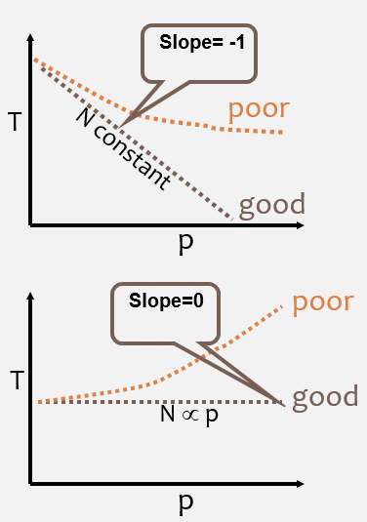
Performance metrics
Scaling: the ability to be efficient in a parallel system.
Strong scaling:
Total problem size is constant
number of cores increases
Suitable for trying to find the fastest setup for the same problem.
Weak scaling:
The total problem size is proportional to the number of cores.
Strong scaling
Weak scaling
Images from the Lawrence Livermore National Laboratory Computing: https://computing.llnl.gov/
Notes:
Scaling - is defined as the ability to be efficient on a parallel machine/environment. It identifies the computing power/speed of execution in proportion with the number of processing elements.
Strong Scaling - the total problem size stays fixed while the number of processing elements increases. This approach is good when trying to run the same problem faster. Perfect scaling would be when the problem is solved in 1/𝑝 time of the serial run.
Weak Scaling - the problem size per processing element stays fixed as the number of processing elements increases. The total problem size is proportional to the number of processing elements. This approach can give more general information about parallel applications by testing if larger problems can be solved in proportional times.
Note: The scalability of a parallel program is a result of multiple interrelated factors. It is often the case that simply adding multiple processors does not improve scalability. In this case, one needs to investigate the inherent limits and bottlenecks of the software. It may be I/O-bound, memory-bound, network-bound, processor speed-bound or may contain multiple non-parallelizable segments.

Slide 34
Exercise 4 (optional) Evaluating advanced performance metrics

Slide 35
Exercise 4 Evaluating advanced performance metrics
Goals:
Calculate the speedup and efficiency of the parallel programs multVec and calcMatrix.py.
Evaluate how each parallel program scales under weak and strong scaling conditions.
Motivation:
Learn to achieve optimal performance.
Learn about your code’s limitations (such as bottlenecks, serial parts).
Learn to precisely estimate your resource needs on HPC through performance analysis.

Slide 36
Exercise 4 Tasks 1-2: Speedup & Efficiency
Open the Jupyter Notebook file: Exercise_4/speedup_efficiency.ipynb You can open the file using the OOD Jupyter notebook app: https://ood.discovery.neu.edu/pun/sys/dashboard/batch_connect/sys/jupyter/session_contexts/new
Follow the instructions in speedup_efficiency.ipynb to produce the speedup and efficiency plots for the multVec program.
Repeat the same steps for the second program calcMatrix.py.
Compare the resulting plots - which program has the highest speedup? Which is more efficient? Does the communication model play a role?

Slide 37
Exercise 4 Tasks 3: Evaluate scaling
Strong scaling – based on the previous exercises, does any of the programs exhibit good strong scaling? Which one?
Weak scaling – enter directory Exercise_4/weak_scaling The data size will now change with number of cores used. Repeat Exercise_1 and Exercise_2 produce the speedup and efficiency plots for both programs. Which one exhibits good weak scaling?
Compare the resulting plots - which program has the highest speedup? Which is more efficient? Does the communication model play a role?

Slide 38
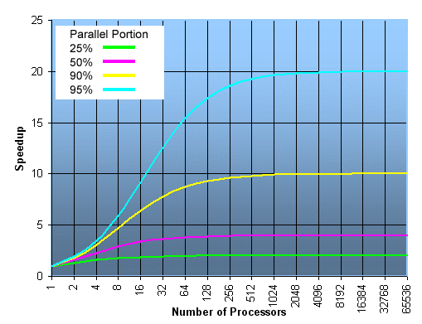

Amdahl’s Law
The maximum speedup that can be achieved is limited by the serial (non-parallel) components:
$$S_{max}=\frac{1}{1−p}$$
1-p denotes the serial component.
Assumes a fixed problem size.
Assumes the overall workload of the program is constant.
Images from the Lawrence Livermore National Laboratory Computing: https://computing.llnl.gov/
Notes:
Amdahl’s insights are often used when designing processors and parallel algorithms. It states that the maximum speedup that can be achieved is limited by the serial(non-parallelizable) components
Where 1−𝑝 denotes the serial component of a program. For example, in a program that has 80% of the code in parallel, the rest 20% is serial. Then the maximum achievable speedup is: 𝑆=1/0.2=8. Meaning that even for an infinite number of processing elements, the parallel program would run 8 times faster than the serial program.
Amdahl’s law assumes a fixed-problem size and assumes that the overall workload of a program does not change with respect to the machine size (# of processors).

Slide 39

Gustafson’s Law:
Addresses the deficiency in Amdahl’s Law and considers the number of resources involved.
The speedup S_{max}, gained by using N cores for a task with serial fraction s (non-parallel part) is:
$$S_{max}=N+\left(1−N\right)s$$
This law redefines efficiency, as the serial part limitations may be countered by increasing increasing the total amount of computation.
Images from the Lawrence Livermore National Laboratory Computing: https://computing.llnl.gov/
Notes:
Gustafson’s Law addresses the deficiency of Amdahl’s law, which does not consider the number of computing resources involved in solving a task. It suggests that the best way to solve the execution time of a parallel problem is to consider all the computing resources, and on the basis of this information it fixes the problem.

Slide 40
Increase MPI performance with InfiniBand

Slide 41
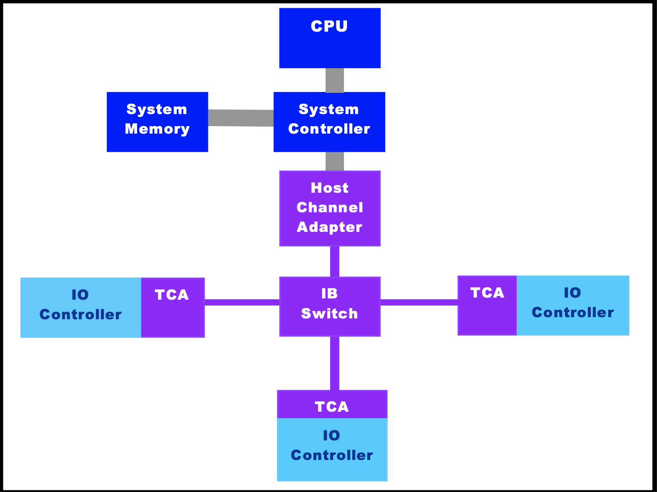
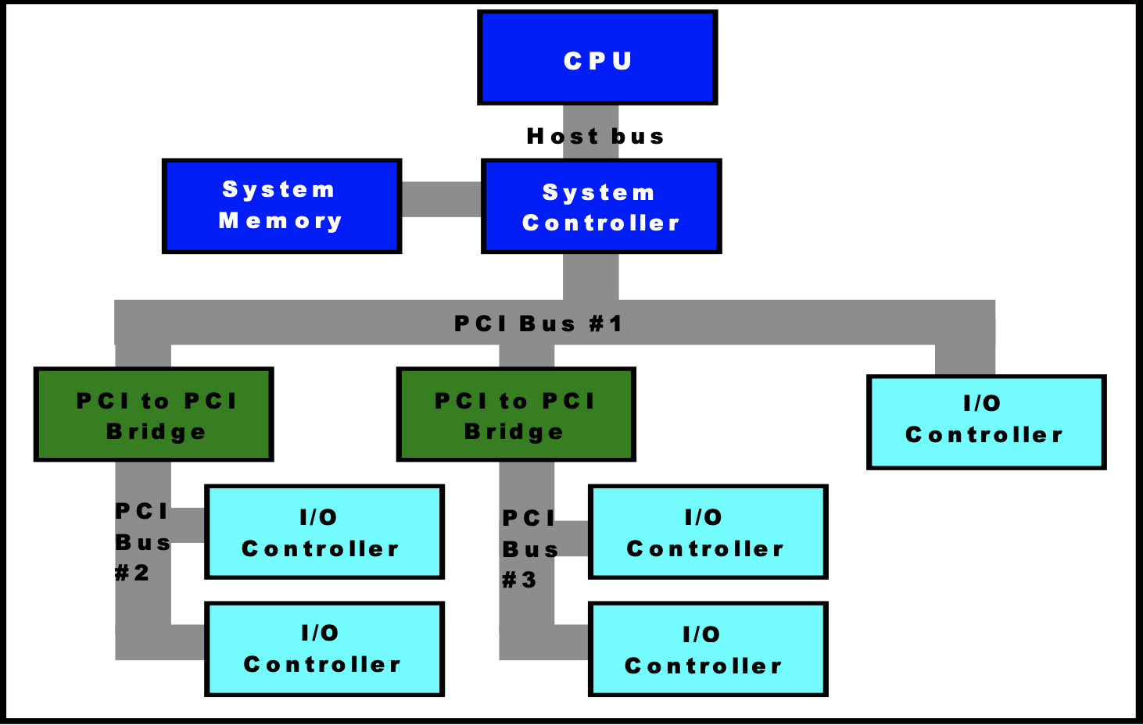
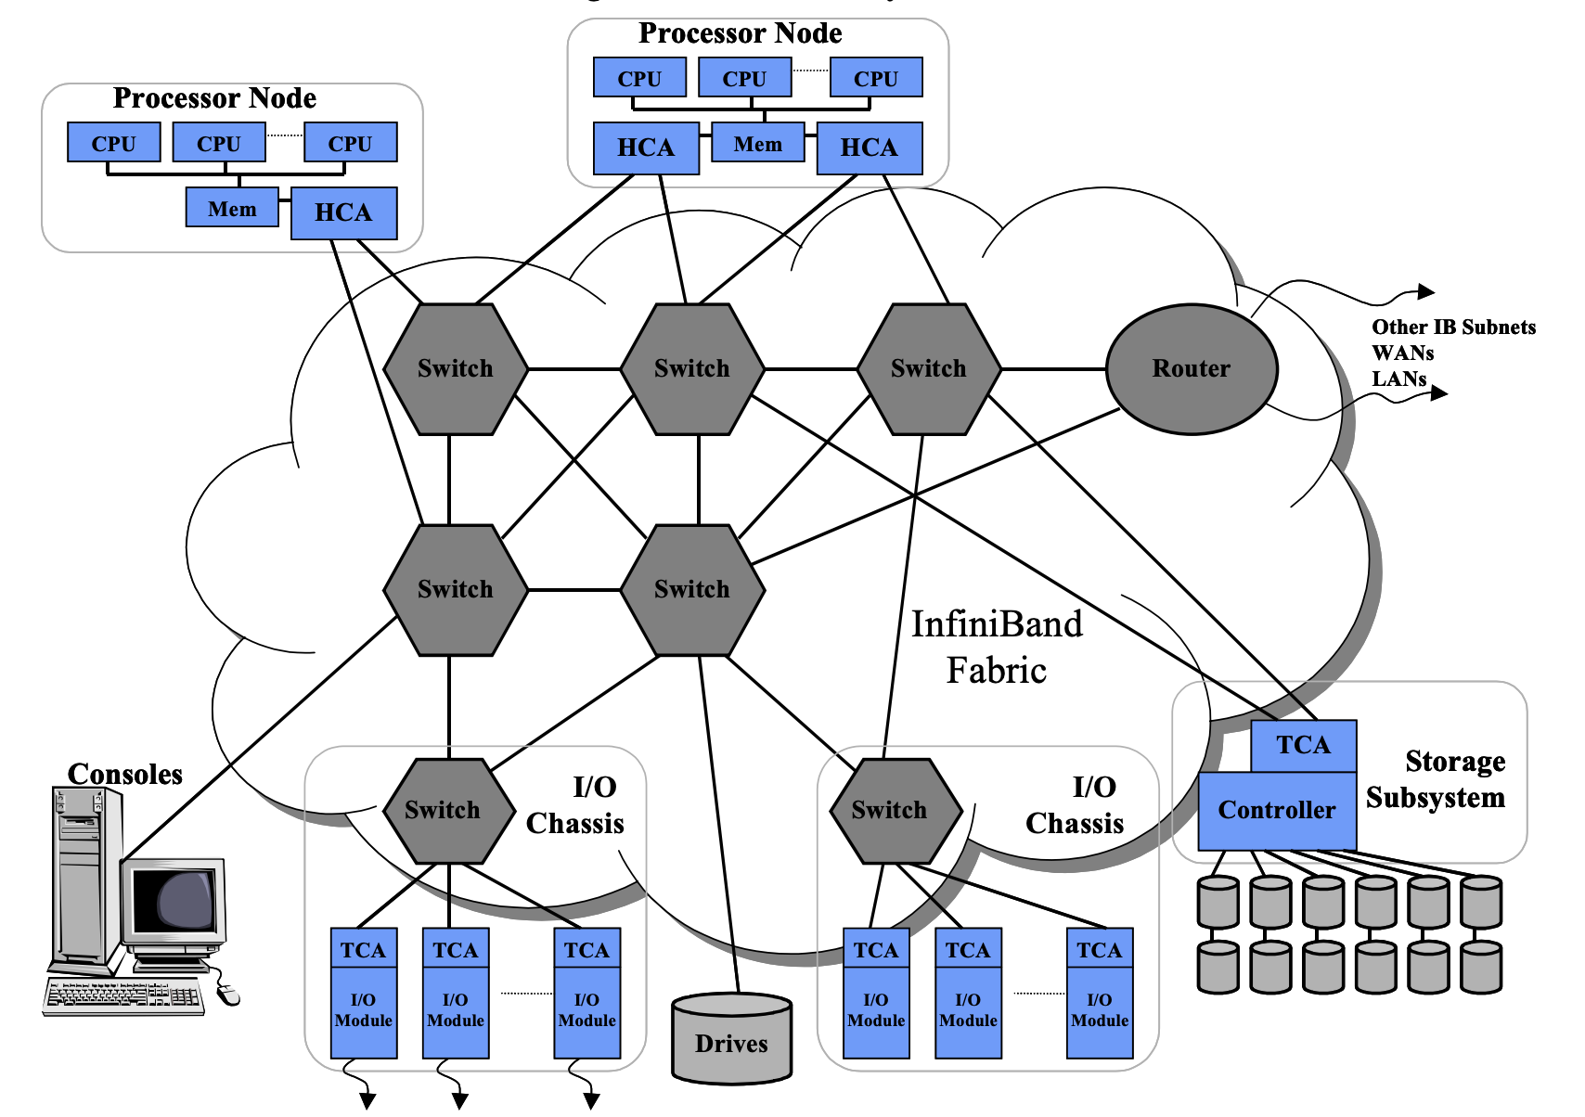
Increase MPI performance with InfiniBand
Discovery offers the InfiniBand 100-200HDR inter-node network that outperforms the regular ethernet 10Gb/s speed, with speeds up to 100-200Gb/s.
Conventional shared-bus architecture:
All communication shares the same bandwidth.
Latency and congestion increases with each bridge added to the system.
Uses Ethernet for server-server communication.
Switched fabric architecture:
Designed for fault tolerance and scalability.
Unlike a shared bus architecture, the aggregate bandwidth of a system increases as additional switches are added to the network.
Notes:
Images taken from Mellanox Technologies: https://www.mellanox.com/pdf/whitepapers/IB_Intro_WP_190.pdf

Slide 42
Run InfiniBand-supported MPI on Discovery
Please note that only the newer d-nodes (Intel Skylake microarchitecture) have InfiniBand network.
To allocate d-nodes, use the following SLURM flag: --constraint=ib
Only MPI programs can use InfiniBand. Use: module show <mpi_library_name> to check if InfiniBand is supported. Some Discovery modules will have “skylake” in their name (similar to the “cascadelake” architecture).
# Allocate 2 d-nodes (Skylake), each has 56 cores:
srun –p express --pty -N 2 –n 112 –t 01:00:00 –-constraint=ib /bin/bash
# First check if the module is InfiniBand-enabled: $ module show mpich/3.3.2-skylake-gcc7.3
# Load the mpich module: $ module load gcc/7.3.0 mpich/3.3.2-skylake-gcc7.3
# Compile and run your program (compilation part not shown…): $ mpirun –n 112 <my_MPI_program>

Slide 43
Enabling InfiniBand Support in Python (optional):
Since MPI is just an API, it supports multiple implementations.
Most MPI implementations (Open MPI, MPICH etc. ) support communication over the InfiniBnand network.
The mpi4py library provides a Python wrapper around your choice of MPI implementation. Please note that the default MPI library installed with mpi4py(using conda or pip install) will not support InfiniBand.
To build mpi4py with InfiniBand support, type (for example using OpenMPI):
# First check if the module is InfiniBand-enabled: $ module show mpich/3.3.2-skylake-gcc7.3
# Load the openmpi module: $ module load mpich/3.3.2-skylake-gcc7.3 # Install mpi4py using mpich:
$ pip install --user mpi4py

Slide 44
Exercise 5 (optional) Increase performance with InfiniBand MPI
Repeat Exercise 2 running on the InfiniBand network. Enter directory Exercise_5 and inspect the main_py.bash script:
Notice the differences in the submission script:
Added flag: #SBATCH --constraint=ib
The use of mpi4py compiled with InfiniBand-supported MPI library. Here, we also load the following libraries:
Submit the job:
Re-evaluate the performance metrics, is there an improvement compared to results from Exercise 2?
$ cat main_py.bash
$ module load gcc/7.3.0 mpich/3.3.2-skylake-gcc7.3
$ module load miniconda3/2020-11-skylake
$ sbatch main_py.bash

